Slide 1

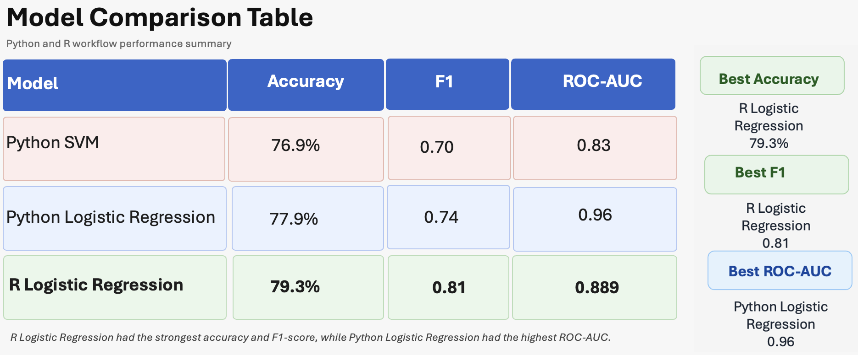
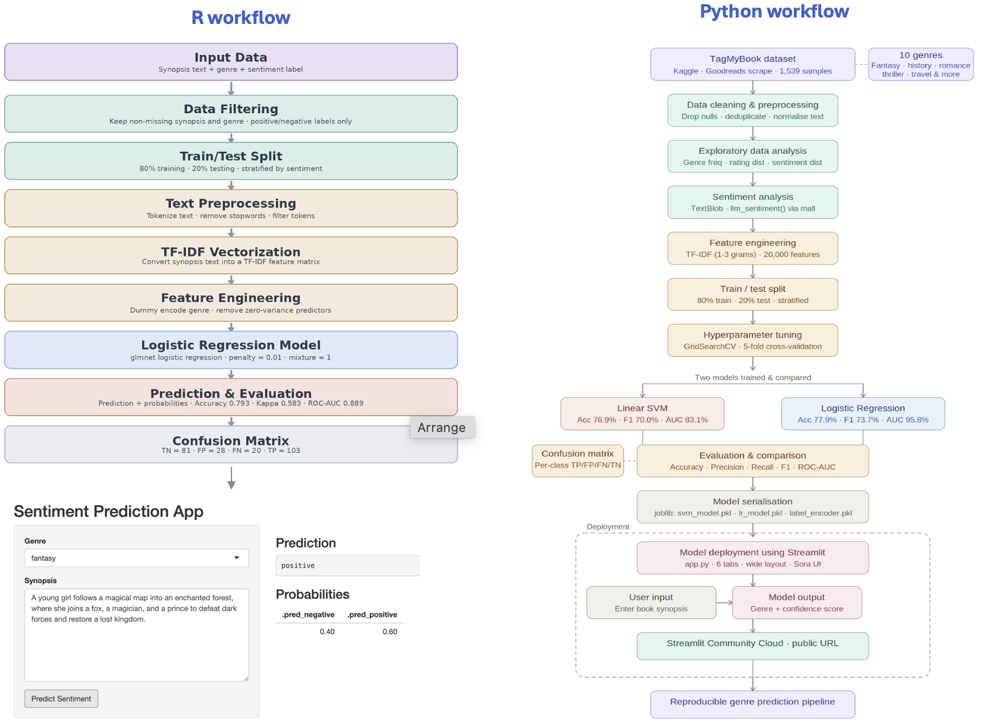
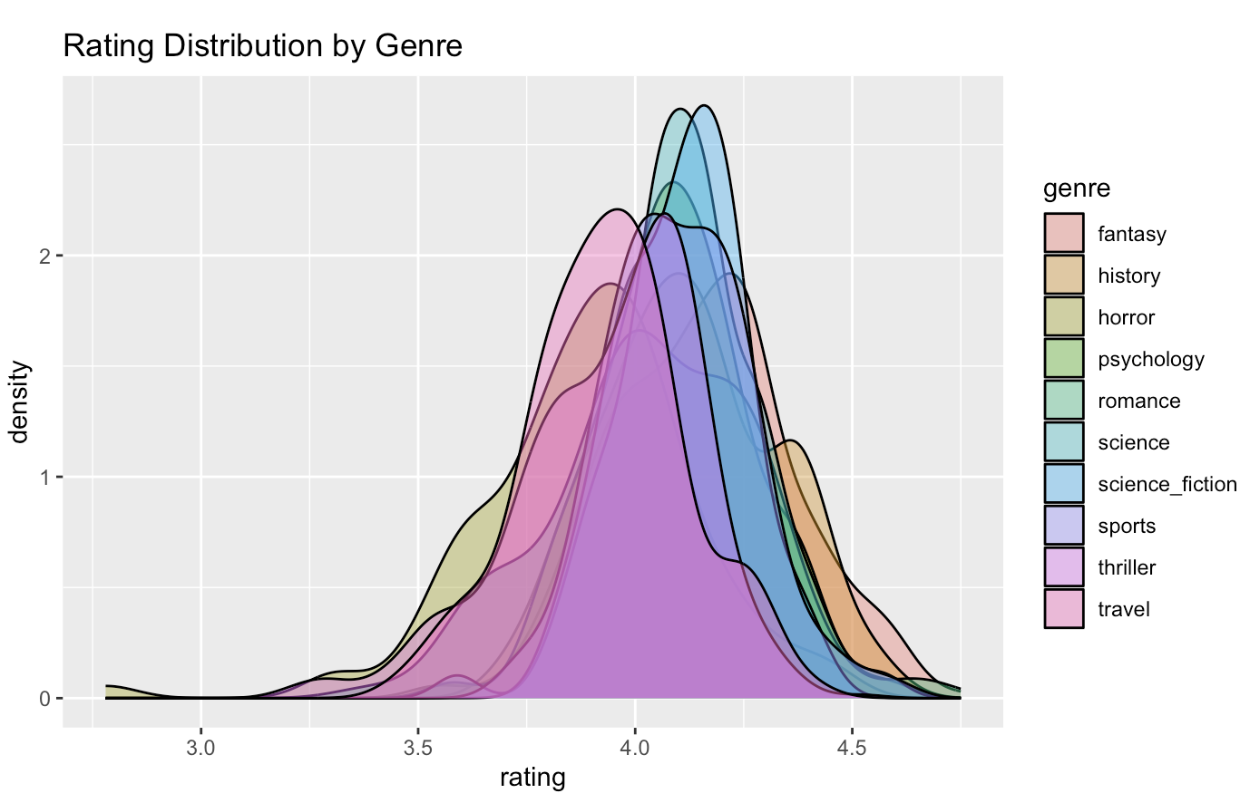
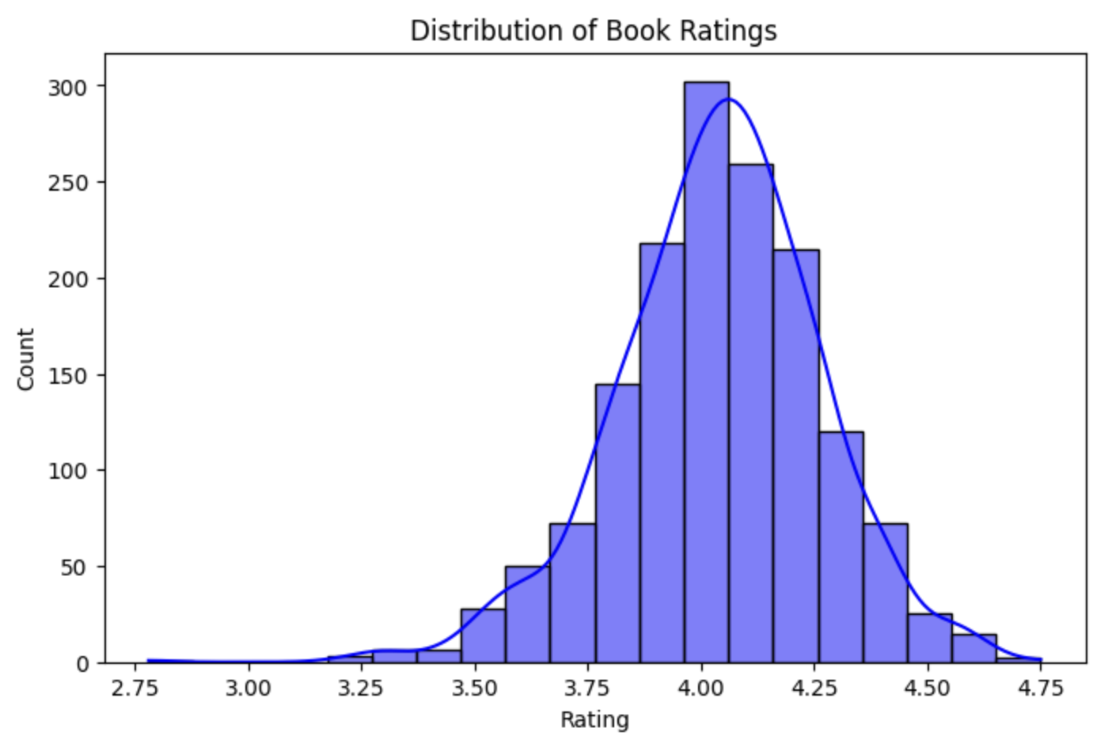
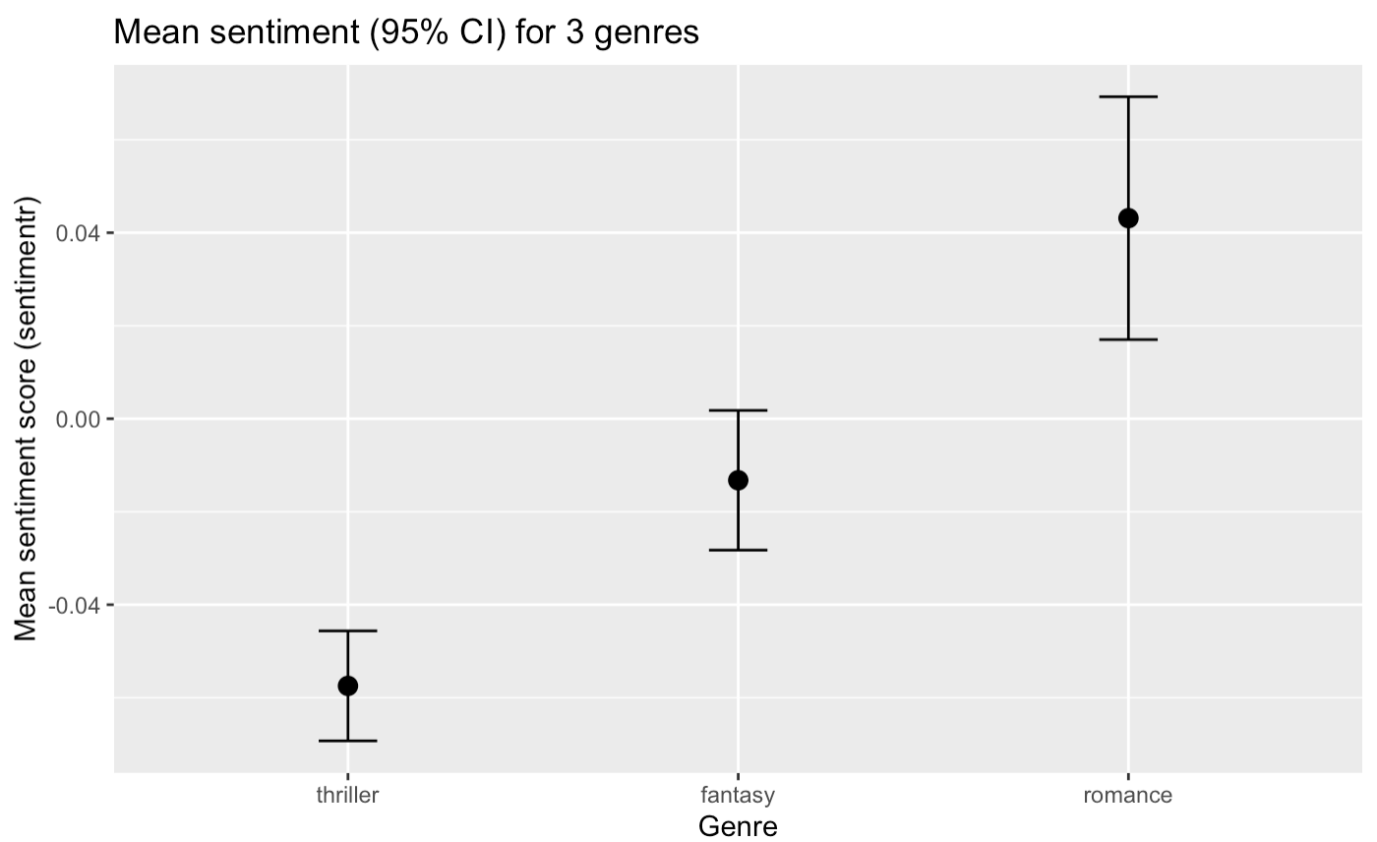
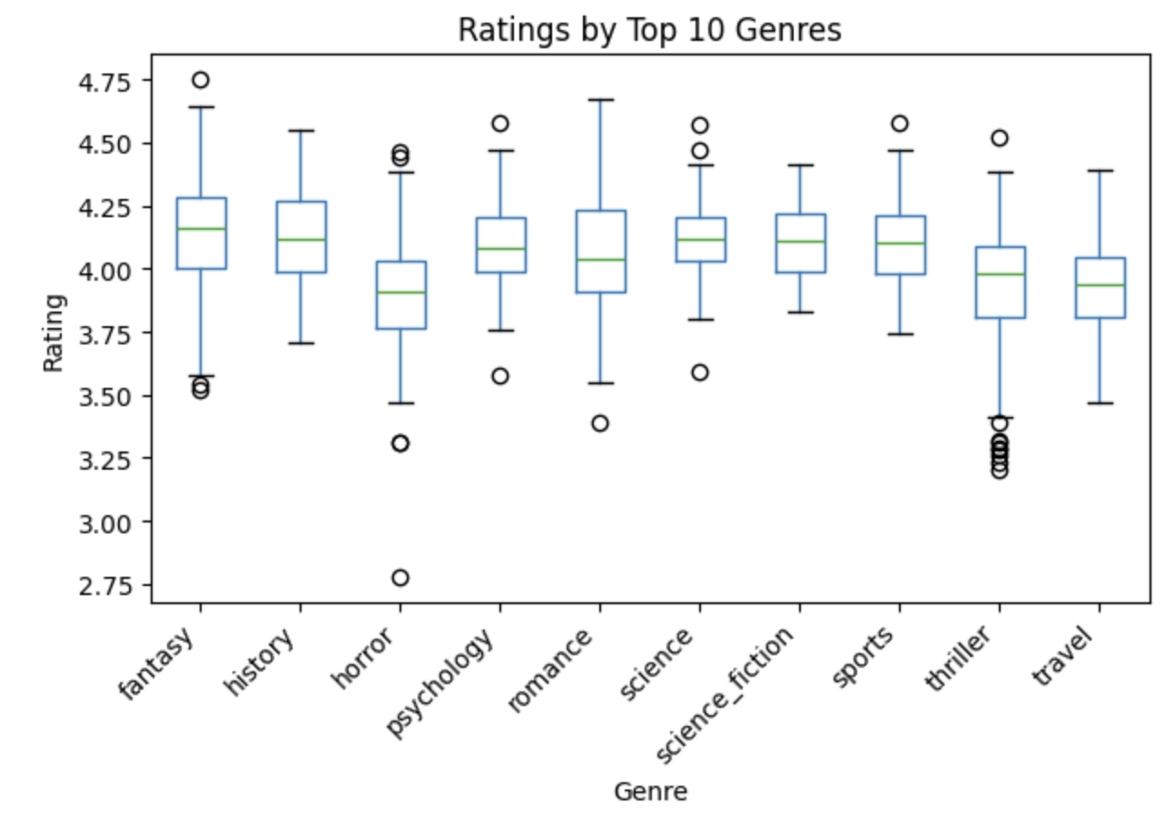
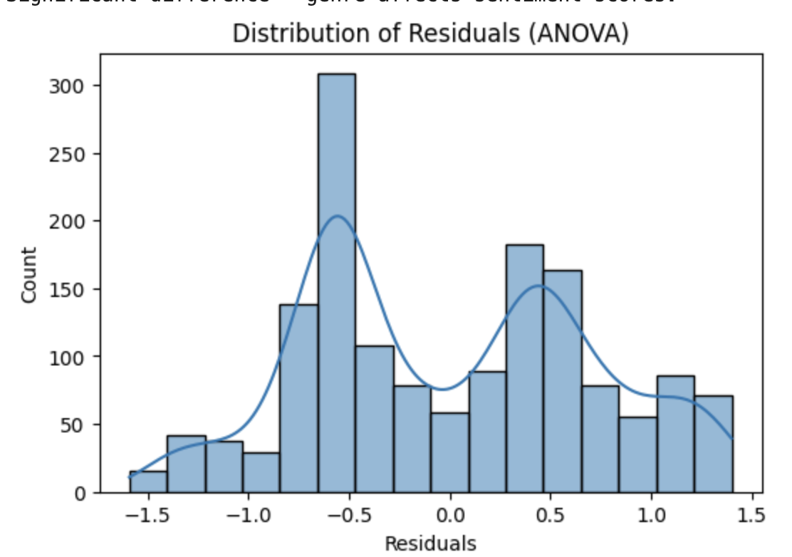
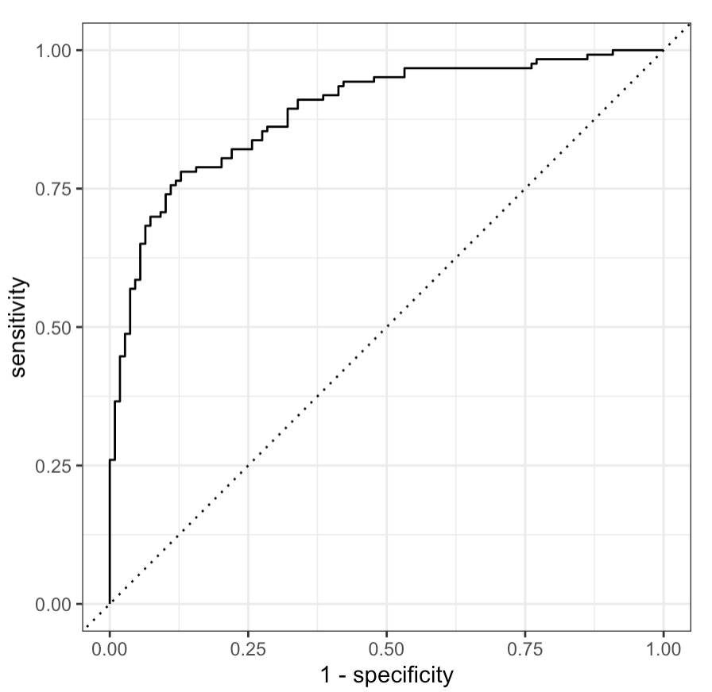
LLM-Driven Book Genre Classification & Sentiment Analysis
Shruti Gajre, Student; Shrusthi HC, Student; Eric A. Suess, Ph.D.
INTRODUCTION
RESULTS
CONCLUSION
Can a machine accurately predict a book’s genre using only its synopsis?
With the rapid growth of digital book content, manual genre classification has become inefficient, inconsistent, and difficult to scale. This research explores whether machine learning and large language models (LLMs) can automate this task effectively.
Using the TagMyBook dataset (1,539 books across 10 genres), we compare two approaches:
Classical machine learning (TF-IDF with Linear SVM and Logistic Regression)
LLM-based zero-shot classification (via mall)
Additionally, sentiment analysis is used to examine how tone and reader ratings vary across different genres.
This project showed that automated analysis of book synopsis text can effectively support both genre classification and sentiment prediction. Across the two workflows, the results confirm that text-based machine learning methods are capable of extracting meaningful patterns from short book descriptions. In the Python workflow, Logistic Regression with TF-IDF features emerged as the strongest classical genre-classification model, achieving 77.9% accuracy and 95.8% ROC-AUC, while also outperforming SVM in overall balance of performance. In the R workflow, Logistic Regression also performed strongly for sentiment prediction, reaching 79.3% accuracy, F1 = 0.81, and ROC-AUC = 0.889, showing that the same general modeling approach remained reliable across a different but related text-classification task.
Taken together, the R and Python results demonstrate that Logistic Regression combined with TF-IDF is a robust and interpretable baseline for NLP classification problems. The Python analysis highlighted its strength for genre prediction, while the R workflow confirmed its usefulness for sentiment prediction using synopsis text and genre information. In addition, the application component made the project practical by translating the trained model into an interactive prediction tool. The deployed app allows users to input genre and synopsis text and receive predictions in real time, showing that the project is not only analytically sound but also usable in a real-world setting.
Logistic Regression achieved a ROC-AUC of 95.8%, significantly outperforming Linear SVM (83.1%)
Genres with the highest F1 scores were fantasy, history, travel, and sports (F1 > 0.82)
Class imbalance affected horror and science fiction, which had fewer training samples
Positive sentiment scores were most prevalent in romance and travel genres
LLM-based zero-shot classification via mall demonstrated competitive performance without any labelled training data
Confusion matrix revealed highest misclassification between science and science fiction genres.
METHODOLOGY
FUTURE WORK
Incorporate transformer-based embeddings (BERT, RoBERTa) for richer semantic feature extraction
Address class imbalance using SMOTE or class-weighted loss functions
Expand the dataset to include more books per underrepresented genre

