Slide 1
Statistics 3502/6304
Prof. Eric A. Suess
Chapter 3

Slide 2
Data Description – One Variable
We see descriptions of data all the time. Look at your phone. Go to the doctor. Drive your car.
The wireless signal one your phone describes how much of a connection you have to a cell tower.
Do you test positive for a disease?
How fast am I going? Am I going too fast? Too slow?

Slide 3
Data Description – One Variable
Today we will discuss the description of data collected on one variable.
We will discuss graphical and numerical methods, such as, pie chart and bar graphs and time plots, and, such as, means, medians, modes and standard deviation.
We will discuss the use of Excel and Minitab to make graphs and to computer descriptive Statistics.

Slide 4
Descriptive Statistics and Inferential Statistics
The field of Statistics is broken into two main areas. One if Descriptive Statistics and the other is Inferential Statistics.
In Descriptive Statistics we work to describe the data and to communicate the big picture and patters in the data.
Inferential Statistics uses probability to model the data and to help reach conclusion about the presence of underlying patterns.
We start with Descriptive Statistics, sometimes called Exploratory Data Analysis.

Slide 5
Graphical Methods
Categories
Data is often simplified into ordered or unordered groups or categories.
Examples:
Gender (Female, Male)
Income (Low, Medium, High)
Industry (Agriculture, Construction, etc.) see Table 3.4 page 63

Slide 6
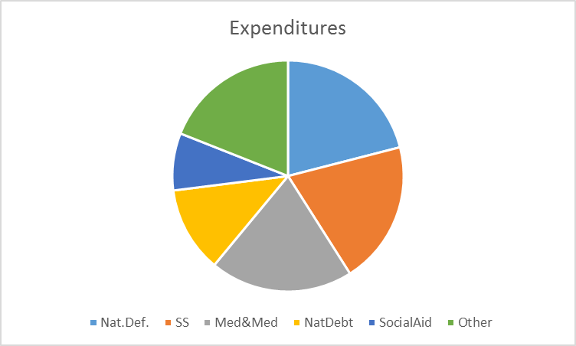
Graphical Methods
Pie Charts
Exercise 3.1
Use MS Excel

Slide 7
Graphical Methods
Pie Charts are used with data that is summarized into categories.
Each slice of the pie represents the portion or percentage of the pie from each category.
Relative Frequency or percentages are usually used.

Slide 8
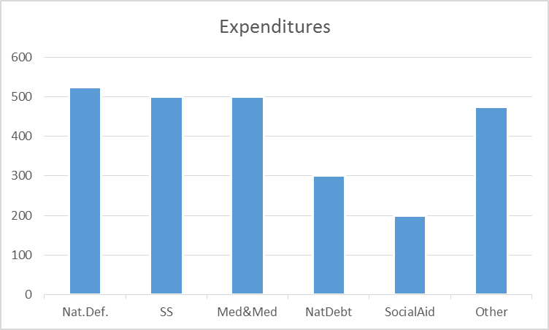
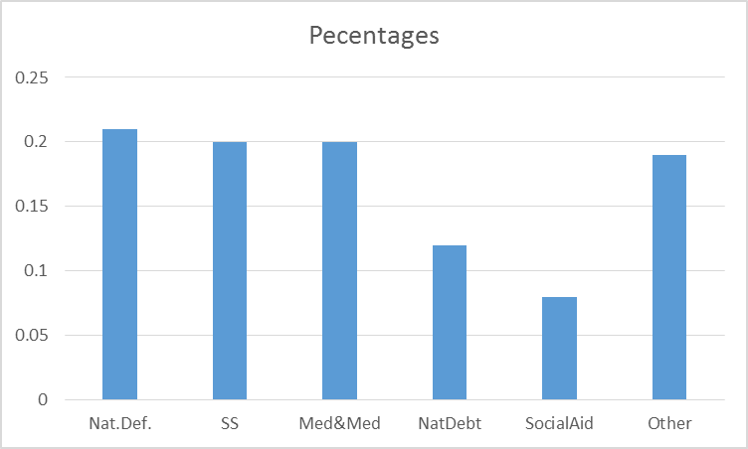
Graphical Methods
Bar Graphs
Exercise 3.1
MS Excel

Slide 9
Data
Data: Data are values recorded for variables from individuals.
There are different types of data.
The two main types of data are:
Qualitative – which means categorical
Quantitative – which means numerical
Examples: Hair Color, Height
Different graphs are used for different types of data.

Slide 10
Types of Graphs
Pie Charts and Bar Graphs are used for Qualitative Data. MS Excel is used to produce these graphs.
Histograms are used for Quantitative Data. Minitab is used to produce these graphs.
Stem-and-Leaf plots are used for Quantitative Data. By hand or Minitab is used to produce these graphs.

Slide 11
Describing the shape of Histograms
Histograms are used to display the distribution of the values of a quantitative variable.
The language:
Unimodal
Bimodal
Uniform
Symmetric
Skewed to the right/+
Skewed to the left/-
Page 71

Slide 12
Making a Stem-and-Leaf plot
Take the values and split them into stems on the left and leaves on the right.
List the stems in order, not skipping and numbers in the list, from smallest to largest.
List the leaves in order to the right.

Slide 13
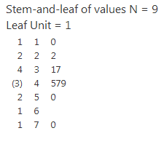
Example
10, 22, 31, 45, 47, 49, 50, 37, 70
Minitab Express
Minitab
Stem-and-leaf of values N = 9
Leaf Unit = 1.0
1 1 0
2 2 2
4 3 17
(3) 4 579
2 5 0
1 6
1 7 0

Slide 14
Time Series
Time Series plots are made for quantitative data recorded in time.
Plots of stock market data is a good example.
See yahoo finance.

Slide 15
General Guidelines for Successful Graphics
See page 77 for the authors guidelines.
The main guideline that is important to consider is the first one.
What message are you trying to send to the viewer?

Slide 16
Numerical Methods – Center and Spread
Measures of central tendency measure the center of the data.
Measures of spread or variation measure the variability of the data.
What is a parameter? A population measure.
What is a statistics? A sample measure.
When we compute these measure we are computing statistics. These days often referred to as Analytics.

Slide 17
Numerical Methods – Center
Mean, Median, Mode
Mode – most common value
Median – 50th percentile, middle
Mean – average

Slide 18
Numerical Methods – Center
To find the median, order the data, find the middle value, if an even number of values, average the two middle values.
To calculate the mean, add all the values together and divide by the number of values.
The sample size is $n$
$$\overline{y}=\frac{y_{1}+y_{2}+…+y_{n}}{n}=\frac{\sum{y}}{n}$$

Slide 19
Numerical Methods – Outliers
What is an outlier?
Values that are a long way away from the rest. Sometime they result from errors in the recording of the data. Other times they are part of the data.
Example: Income

Slide 20
Numerical Methods – Spread
What is less variable?
What is more variable?
Figure 3.16 on page 86

Slide 21
Numerical Methods – Spread
Range = Maximum value – Minimum value
The p-th percentile, value with p% of the values below.
Note pages 88-89 can be skipped. Graduate student should read these pages.

Slide 22
Numerical Methods – Spread
Inner Quartile Range = 75th percentile – 25 percentile
Deviation – how far a value is from the mean $y_{i}−\overline{y}$
Variance – sample variance $s^{2}=\frac{\sum{{\left(y_{i}−\overline{y}\right)}^{2}}}{n−1}$
Standard Deviation – sample standard deviation $s=\sqrt{s^{2}}$
Use MS Excel or Minitab to compute these values for a data set.

Slide 23
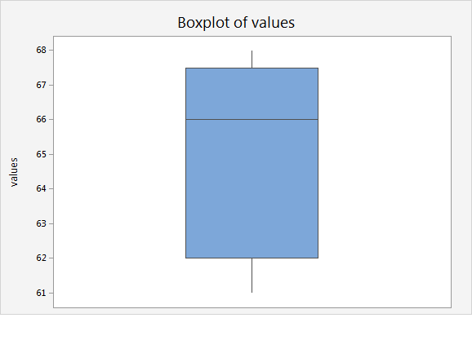
Example
Figure 3.21 page 91 68, 63, 67, 61, 66

Slide 24
Numerical Methods – Spread
Empirical rule – 68-95-99 rule, page 93
Given a set of $n$ values possessing a mound-shaped histogram, then
$\overline{y}±s$ contains approximately 68% of the observations
$\overline{y}±2s$ contains approximately 95% of the observations
$\overline{y}±3s$ contains approximately 99.7% of the observations
See Figure 3.22 page 94

Slide 25
Numerical Methods – Spread
Box Plots plot the 5 number summary
Minimum, 25th percentile, Median, 75th percentile, Maximum
Use Minitab to produce Box Plots.

Slide 26
Next Time
Next Time we will discuss how to describe data for two or more variables.
Contingency Tables
Stacked Bar Graphs
Cluster Bar Graphs
Scatterplots, the Scatterplot matrix

