Slide 1
Statistics 3502/6304
Prof. Eric A. Suess
Chapter 4

Slide 2
Central Limit Theorem
We will discuss the distribution of the sample mean $\overline{x}$ when sampling from a population with mean $μ$ and standard deviation $σ$.
The main assumption is that the sample is a random sample.

Slide 3
Sampling Distribution
The idea of a Sampling Distribution is that the distribution of a statistic, such as $\overline{x}$, can be determined by looking at the statistics after repeated samples are taken and the statistics is computed many times. The resulting histogram of the many compute sample statistics shows the sampling distribution.
See pages 186, 187
This is what Project 1 is all about.

Slide 4
Central Limit Theorem
Let $\overline{x}$be the sample mean computed from a random sample of n measurements from a population having mean $μ$ and standard deviation $σ$. Based on repeated samples of size n from the population, we can conclude the following:
Mean of the sampling distribution of $\overline{x}$ is$μ$
Standard Deviation of the sampling distribution of $\overline{x}$ is $σ/{\sqrt{n}}$

Slide 5
Central Limit Theorem
3. When n is large the sampling distribution of $\overline{x}$ will be approximately normal.
4. When the population is normal the sampling distribution will be exactly normal.

Slide 6
Using the CLT
Z-score
$$z=\frac{\overline{x}−μ}{σ/\sqrt{n}}$$
Used to compute probabilities related to the sample mean $\overline{x}$ .
See Example 4.24 on page 189, 190

Slide 7
Normal Approximation to the Binomial
For large n and $π$ not too close to 0 or 1, the distribution of a Binomial random variable x may be approximately normal with
Mean $μ$=$nπ$
Standard Deviation $σ=\sqrt{nπ(1−π)}$
The approximation can be used is $nπ$ $≥5$ and $n(1−π)$ $≥5$

Slide 8
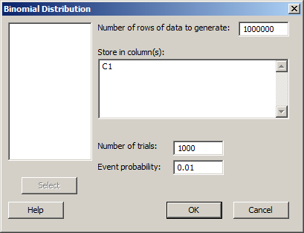
Simulation
Simulate lottery, with n = 1000 and $π$ = 0.01, doing the sampling 1,000,000 times.
Minitab Calc > Random Data > Binomial

Slide 9
How is the normal approximation

